Slide 1
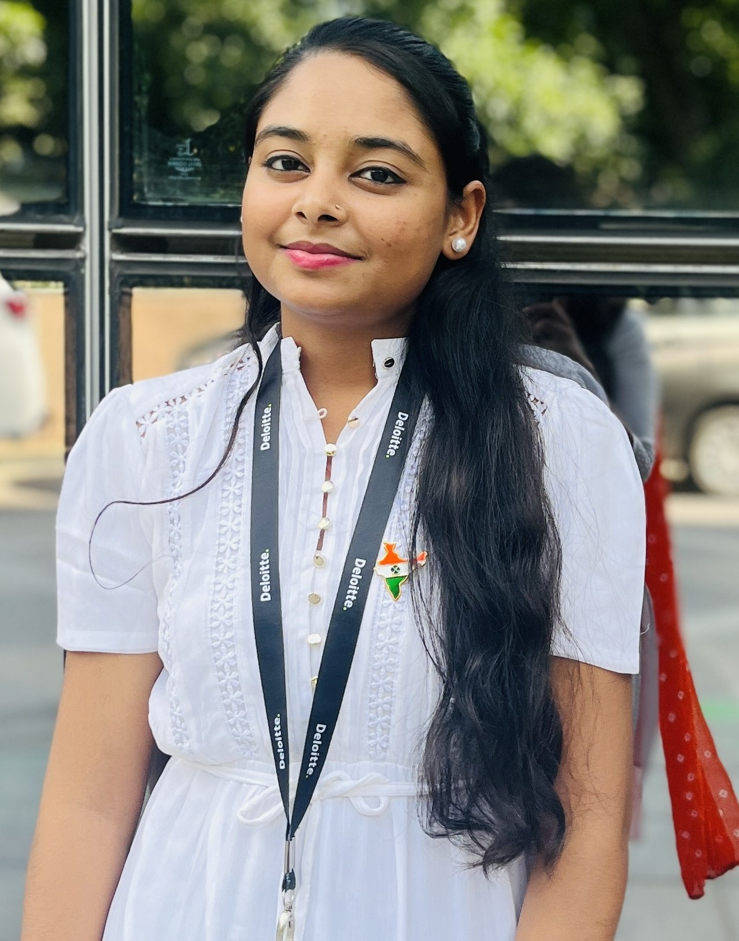

Profile
Aradhana SAP Consumption Management
Summary of professional experience
Recently onboarded as an Analyst , focusing on learning SAP systems and support business process analysis . Actively participating in training sessions to upskill in SAP modules and other related technologies.
Aradhana,
SAP Consumption Management
Deloitte India
email : aaradhana@deloitte.com Mobile: +91-8630273166
Key Skills
Relevant experience
Technology Skills
Html ,Css , Javascript
React.js
Next.js
C,C++
Tailwind
Sql
Languages
English
Hindi
Industry Experience
Frontend developer
Education
Bachelor of Technology: Computer Science and Engineering
E-commerce Websites: You have built e-commerce websites using HTML, CSS, JavaScript, React, and Tailwind, incorporating functionalities like product listings, shopping carts, and user authentication.
Online Movie Booking Systems: You developed the frontend of online movie booking systems with similar technologies, focusing on user interface and seat selection functionalities.
Frontend Development for Generative AI: Built and optimized responsive, interactive user interfaces for AI-driven applications using Next.js and Tailwind CSS, enhancing performance and user experience.
Collaborated with backend teams to visualize AI outputs through real-time data displays and intuitive dashboards, improving overall usability.
Integrated dark mode, accessibility features, and interactive design elements to ensure adaptability, inclusivity, and a seamless user experience.

